Slide 1
Option Strategy Builder
Front end Developer

Slide 2
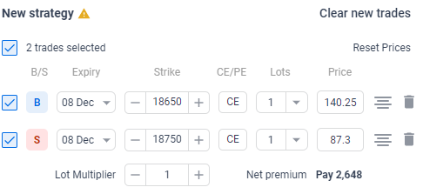
Select Expiry Date
Select Call/Put
For delete row
Buying/Selling
Strike price
I require a simple front-end from where I can provide inputs for options.
Inputs : Buying/Selling, select Expiry Date, Strike price, Call/Put, and Lot size.
We can add or remove the input row.

Slide 3
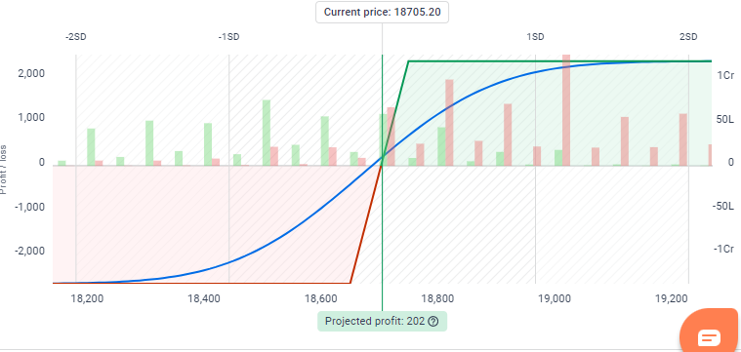
As shown in the first figure we are giving inputs. So, using that input it should show this kind of graph in the front-end. The function for this graph is already created.
We have to use that function to show the graph.

Slide 4
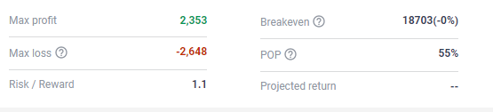
1. Also, we have to show these values. For this also function is already created

Slide 5
Thank You

